Slide 1



Approximate Graph Propagation
Hanzhi Wang, Mingguo He, Zhewei Wei*, Sibo Wang, Ye Yuan, Xiaoyong Du, Ji-Rong Wen
Contact: zhewei@ruc.edu.cn
Notes:
Hello everyone, I’m Hanzhi Wang from Renmin University of China. It’s my pleasure to share our work “Approximate Graph Propagation”. This work is under supervised by my tutor, professor Zhewei Wei at Renmin University of China. We also have cooperators from the Chinese University of HongKong and Beijing Institute of Technology.

Slide 2
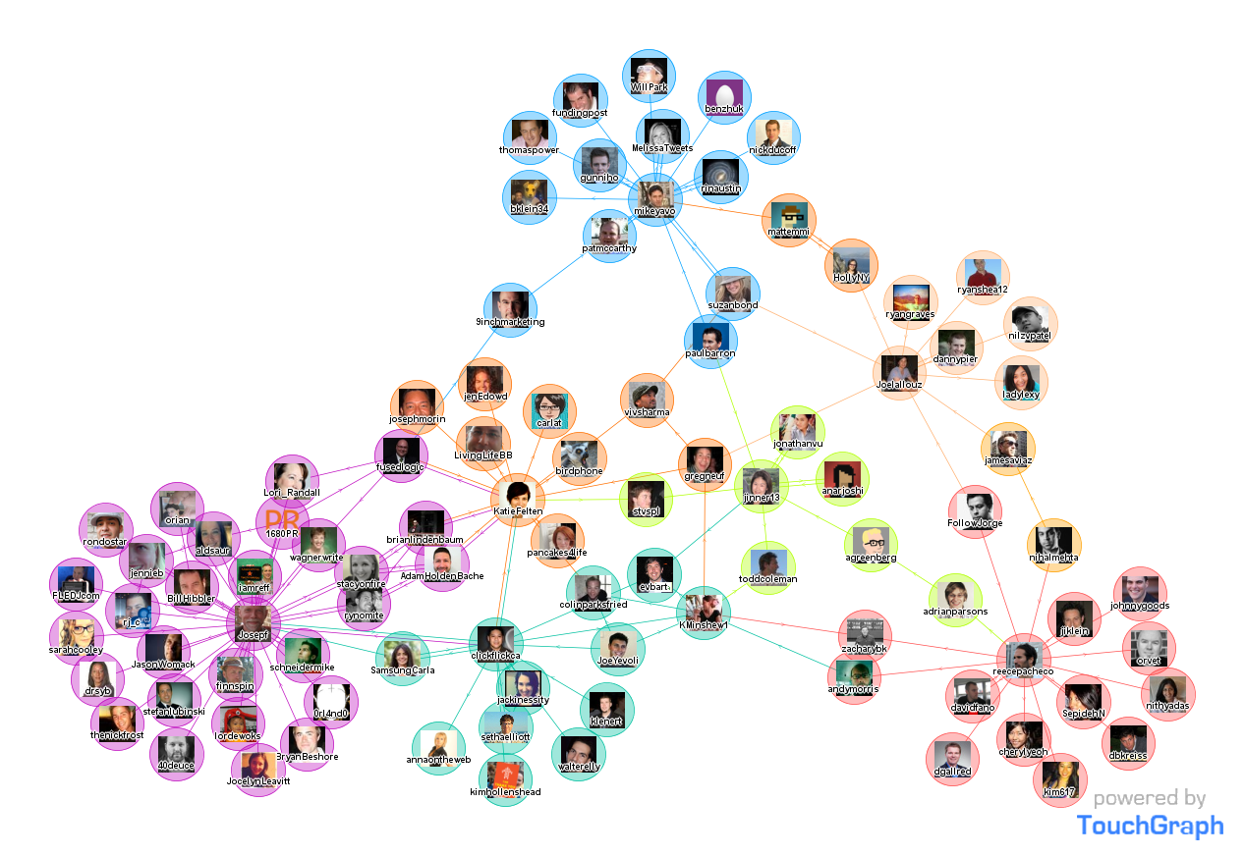
Graphs are ubiquitous
social networks
nodes: users
edges: friendship
Notes:
In this work, we focus on the graph propagation problems. Actually, graphs are ubiquitous[juːˈbɪkwɪtəs] in our life. We can use graphs to represent many real network structures. For example, in social networks, we can view the users as nodes, and view the friendship between users as the edges in the graphs.

Slide 3
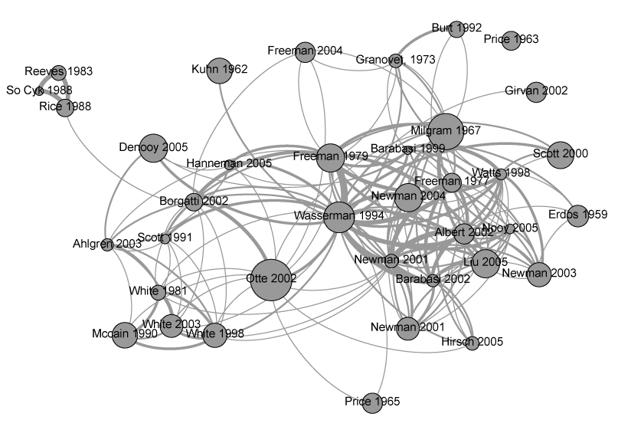
Graphs are ubiquitous
citation networks
nodes: papers
edges: citations
Notes:
In citation networks, the paper can be represented by nodes. The paper citations can be represented by edges.

Slide 4
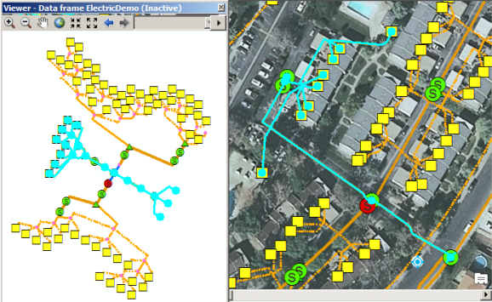
Graphs are ubiquitous
geographic networks
nodes: locations
edges: roads
Notes:
Similary, we can use graph to represent the geographic networks, where the nodes correspond to the physical locations, and the edges correspond to the roads. In a word, graph is a powerful data structure to represent the real networks.

Slide 5
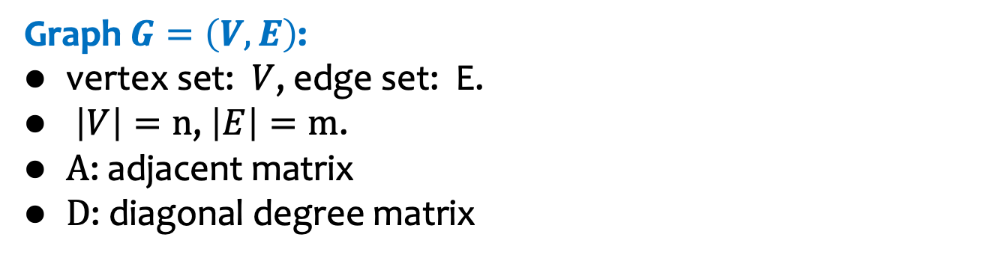
Graph
Graph $G=\left(V,E\right)$:
vertex set: $V$, edge set: E.
$\left|V\right|=n$, $\left|E\right|=m$.
$A$: adjacent matrix
$D$: diagonal degree matrix
10
9
12
2
1
8
3
11
4
6
5
7
Notes:
So here, we first present some definitions. A graph contains a vertex set V and an edge set E. Through this presentation, we will use n and m to denote the number of nodes and edges on the graph. Besides,(Click!) we use A to denote the adjacent[əˈdʒeɪsnt] matrix of the graph, (Click!) and D to denote the diagonal degree matrix.

Slide 6
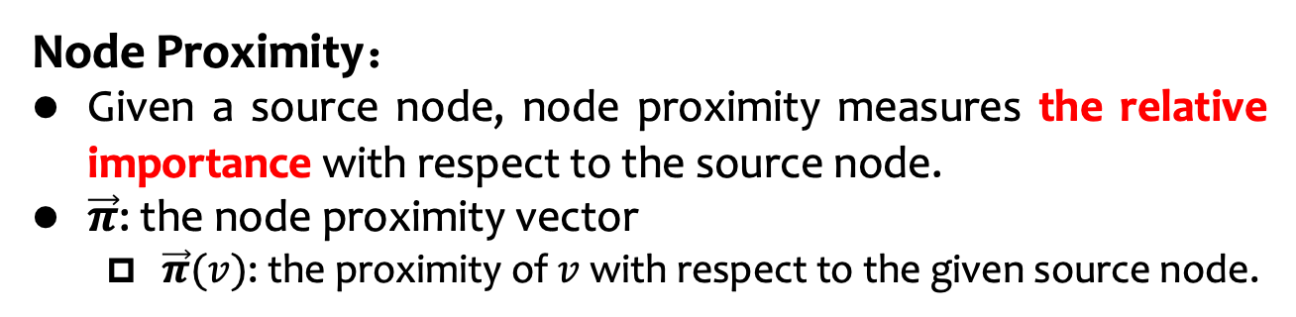

Node Proximity
Node Proximity：
Given a source node, node proximity measures the relative importance with respect to the source node.
$\vec{π}$: the node proximity vector
  $\vec{π}(v)$: the proximity of $v$ with respect to the given source node.
“distances” on the graph
0.04
0.03
0.13
0.1
0.13
0.2
0.13
0.05
0.05
0.08
0.04
0.03
0.04
0.02
10
0.10
9
12
0.13
2
0.08
0.02
1
8
0.13
11
3
0.04
$$\vec{π}=$$
4
In this example:
source node: 4
0.05
6
5
0.13
7
0.05
Notes:
Because the graph data is non-Euclidean[ju:'klidiən] data. No physical distances between the nodes can be measured. Hence, as a somewhat substitute of the distance concept, in the graph structure, we use node proximity to measure the nodes’ relative importances with respect to a given source node. For example in the given graph, (Click!) we select node 4 as the source node. Node 4 has more connections with nodes 1,3,5 than the nodes 10,11 and 12. Hence, the proximity values of node 1,3 and 5 are higher than other nodes. For convenience,(Click!) we use a vector \pi to record all nodes’ proximity values with respect to the given source node.

Slide 7
Node Proximity
Popular Node Proximity Metrics：
L-hop transition probability.
PageRank and Personalized PageRank (PPR).
Heat kernel PageRank (HKPR).
Katz.
Notes:
Here we list some popular node proximity metrics, that is L-hop transition probability, PageRank and Personalized PageRank, Heat Kernel PageRank, and Katz. Let’s make a quick review for the four proximity metrics.

Slide 8
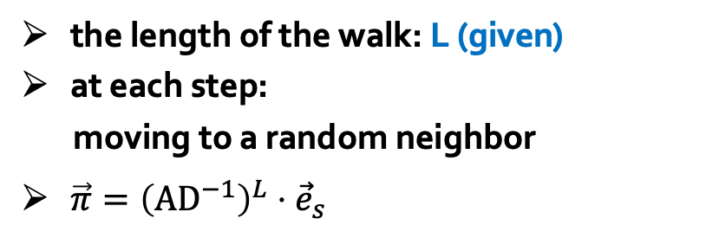







L-hop Transition Probability
10
9
12
2
1
8
3
11
$$1/4$$
$$1/3$$
$$1/3$$
4
the length of the walk: L (given)
at each step:
moving to a random neighbor
$\vec{π}={\left(AD^{−1}\right)}^{L}⋅{\vec{e}}_{s}$
$$1/3$$
$$1/4$$
6
$$1/4$$
5
$$1/4$$
$$1/4$$
7
Notes:
(Click!) For L-hop transition proability, it uses the transition probability of a random walk to measure the node proximity. The random walk starts from the source node s. And the length of the walk is given by a fixed number L. In each step, the walk picks a random neighbor node to move.

Slide 9
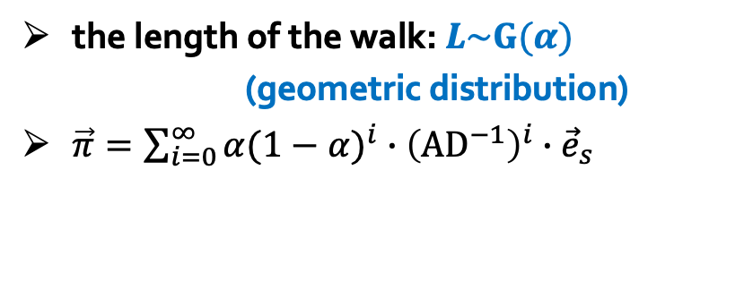


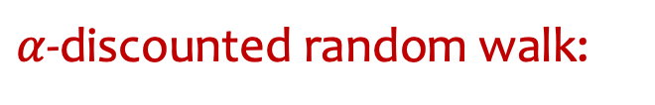
Personalized PageRank (PPR)
10
9
12
2
1
8
3
11
4
$α$-discounted random walk:
returns to the source node, w.p. $α$
6
moves to a random out-neighbor, w.p. $1−α$
5
the length of the walk: $L\sim G(α)$
(geometric distribution)
$\vec{π}=\sum_{i=0}^{∞}{{α(1−α)}^{i}∙{\left({AD}^{−1}\right)}^{i}∙{\vec{e}}_{s}}$
7
PPR $π(s,t)$=Pr{the $α$-walk starting from $s$ walks at $t$}
Notes:
(click!) For Personalized PageRank, or PPR for short, the PPR value pi(s,v) equals to the probability that the alpha discounted random walk starting from node s walks at node t. Here, the alpha discounted random walk means at each step, the walk either returns to the source node with alpha probability, or moves to a randomly selected neighbor with probability 1 minus alpha. The length of the alpha-discounted random walk follows the geometric distribution with parameter alpha.

Slide 10
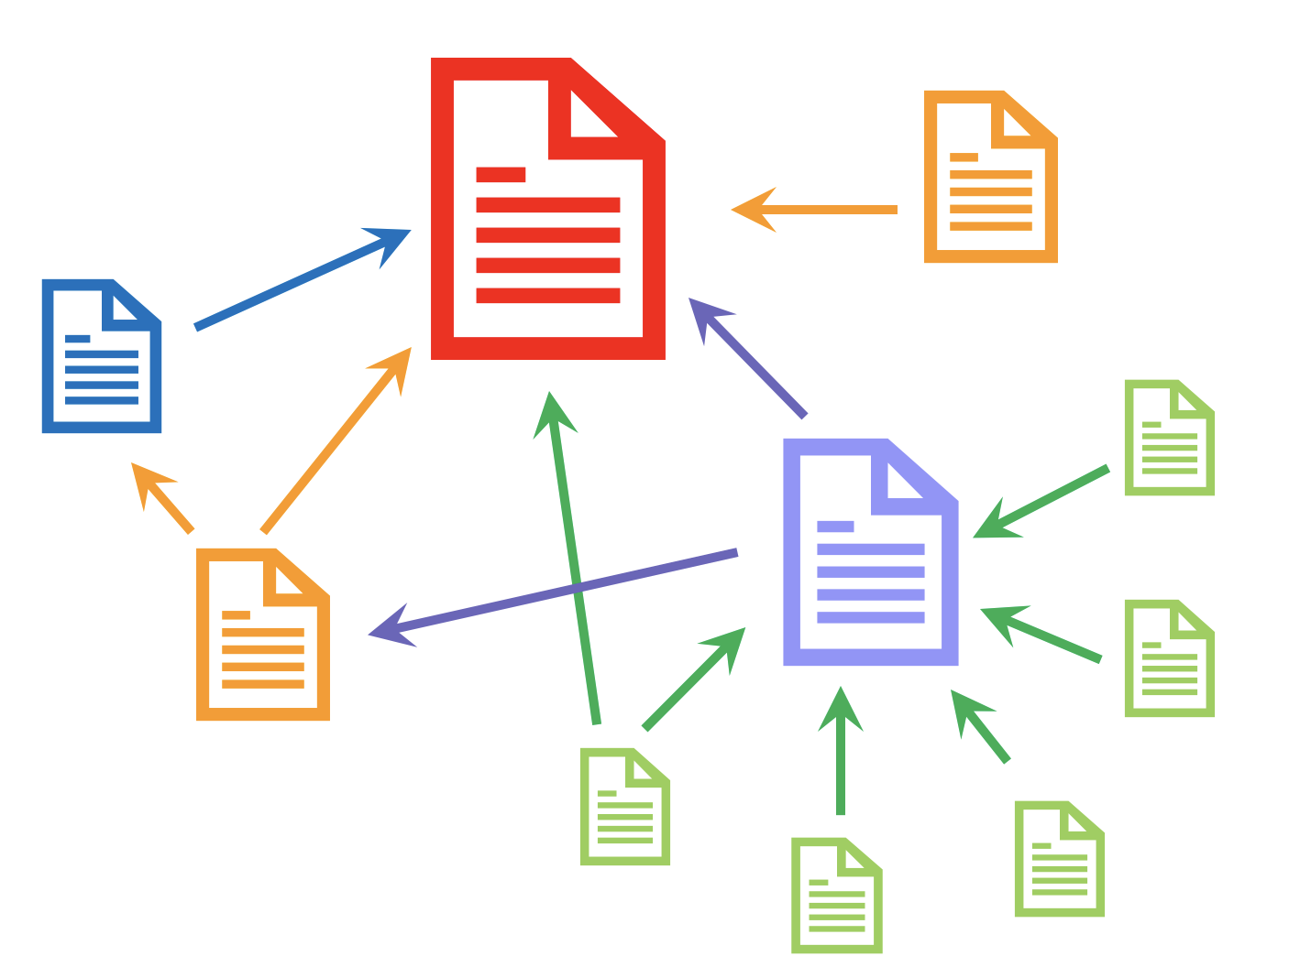
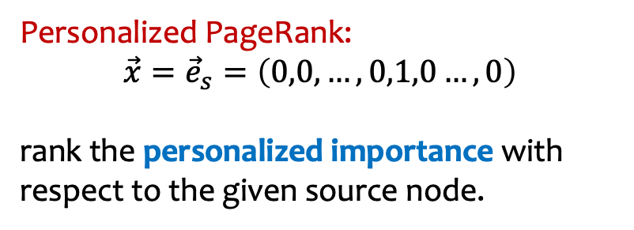

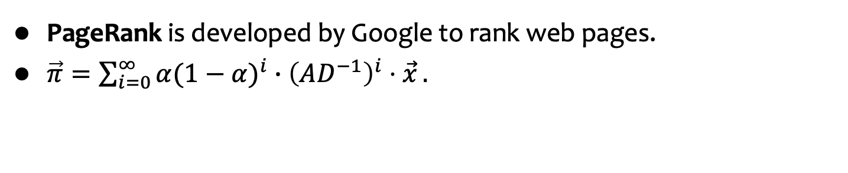
PageRank and Personalized PageRank
PageRank is developed by Google to rank web pages.
$\vec{π}=\sum_{i=0}^{∞}{{α(1−α)}^{i}∙{\left(AD^{−1}\right)}^{i}⋅\vec{x}}.$
PageRank: $\vec{x}=\left(\frac{1}{n},\frac{1}{n},…,\frac{1}{n}\right)$
rank the overall importance of a node.
Personalized PageRank:
$$\vec{x}={\vec{e}}_{s}=\left(0,0, …,0,1,0…,0\right)$$
rank the personalized importance with respect to the given source node.
the s-th entry
Notes:
Actually, PPR is a by-product of the PageRank. PageRank is first proposed by the two co-founders of Google to rank pages in the web. The inituion of PageRank is: a page is important if it is referenced by many pages, or important pages. PageRank is nearly the same as Personalized PageRank. They all use the teleport probability of the random walk whose length follows the geometric distribution as the value of node proximity. The only difference is: (Click!) PageRank measures the overall importance of a node and it thinks each web page has the same importance in the beginning. (Click!) While Personalized PageRank thinks the source node is the most important in the initial state. Hence, we view Personalzied PageRank as a metric for personalized importance with respect to the given source node.

Slide 11
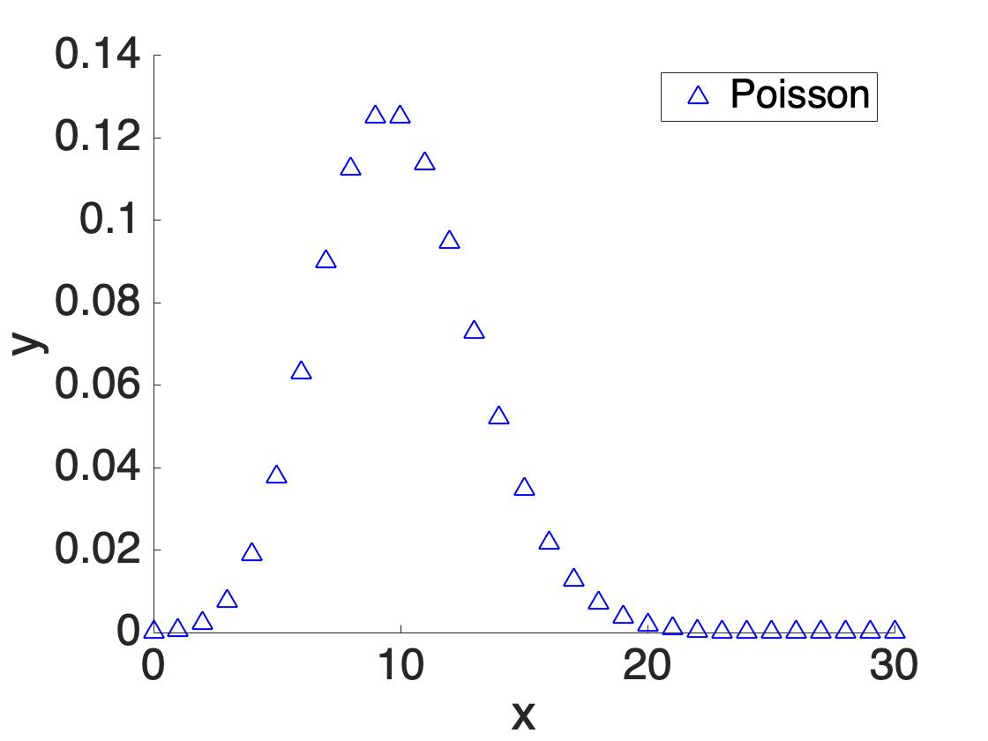
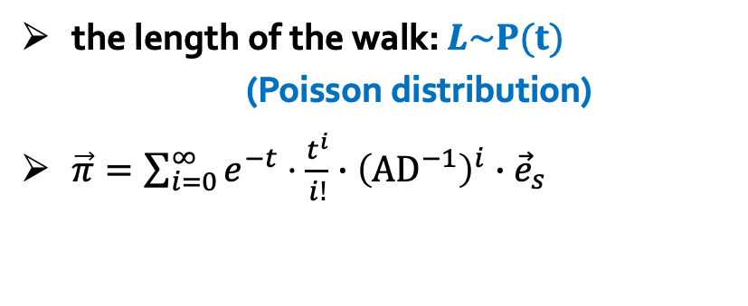
Heat Kernel PageRank (HKPR)
10
9
12
2
1
8
3
11
4
6
L=5
L=13
L=10
5
the length of the walk: $L\sim P(t)$
(Poisson distribution)
$\vec{π}=\sum_{i=0}^{∞}{e^{−t}⋅\frac{t^{i}}{i!}∙{\left({AD}^{−1}\right)}^{i}∙{\vec{e}}_{s}}$
7
Notes:
(Click!) Furthermore, Heat Kernel PageRank is a variant of Personalized PageRank. Heat kernel PageRank uses the teleport probability of a random walk starting from the given source node to compute the node proximity. The length of the random walk in heat kernel PageRank follows the poisson [pwa:sɔn] distribution with parameter t.

Slide 12
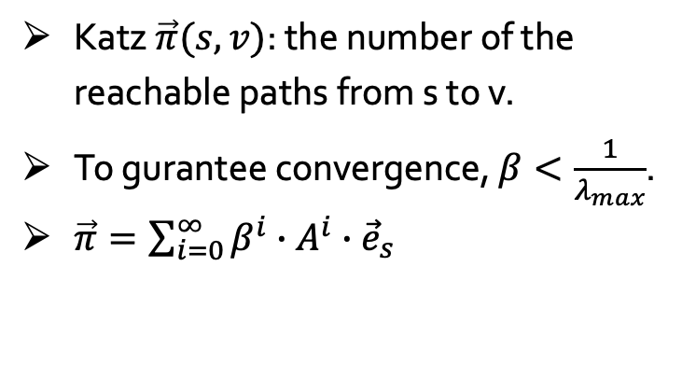
Katz
10
9
12
2
1
8
3
11
4
Katz $\vec{π}(s,v)$: the number of the reachable paths from s to v.
To gurantee convergence, $β<\frac{1}{λ_{max}}$.
$\vec{π}=\sum_{i=0}^{∞}{β^{i}∙A^{i}∙{\vec{e}}_{s}}$
6
5
7
Notes:
[Click!] Things become a little different in Katz. Katz index is another popular proximity measurement. It uses the number of reachable paths from the source node to other nodes on the graph as node proximities. Katz also adds a parameter beta to guarantee convergence [kənˈvɜːrdʒəns].

Slide 13
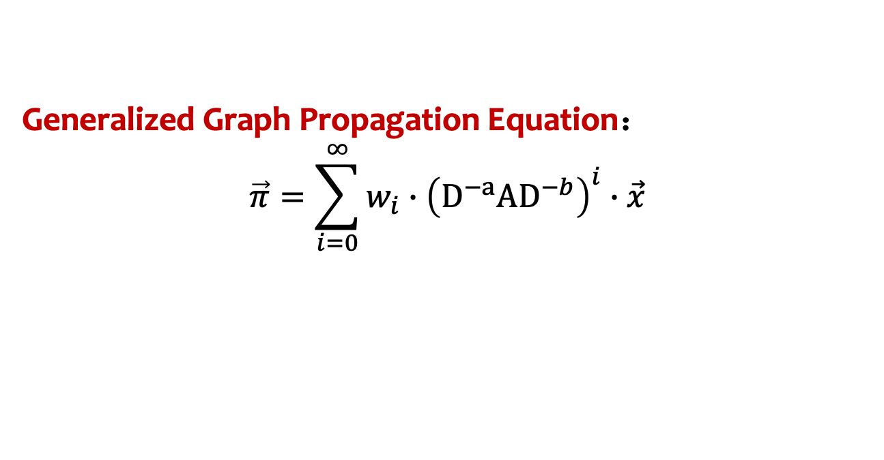
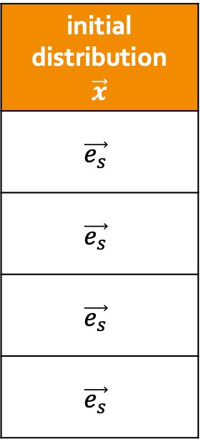
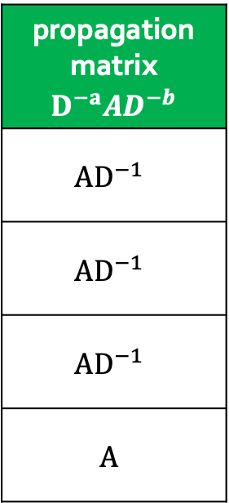
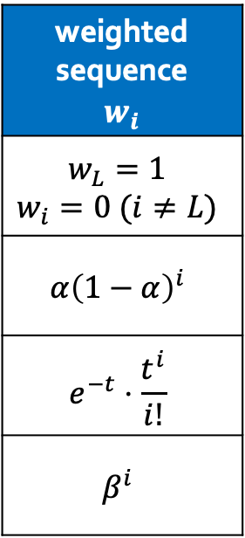
Generalized Graph Propagation
Generalized Graph Propagation Equation：
$$\vec{π}=\sum_{i=0}^{∞}{w_{i}∙{\left({D^{−a}AD}^{−b}\right)}^{i}∙\vec{x}}$$
weighted sequence $$w_{i}$$
$$w_{L}=1$$ $$w_{i}=0 (i≠L)$$
$$α{\left(1−α\right)}^{i}$$
$$e^{−t}⋅\frac{t^{i}}{i!}$$
$$β^{i}$$
propagation matrix $${D^{−a}AD}^{−b}$$
$${AD}^{−1}$$
$${AD}^{−1}$$
$${AD}^{−1}$$
$$A$$
initial distribution $$\vec{x}$$
$$\vec{e_{s}}$$
$$\vec{e_{s}}$$
$$\vec{e_{s}}$$
$$\vec{e_{s}}$$
transition probability
PPR
HKPR
Katz
Notes:
Reviewing all these node proximity metrics, we can summarize a generalized graph propagation equation. [Click!] The weighted sequence w_i controls the length of the random walk. [CLICK!] The parameters a and b determine the propagation structures, such as forward propagation or backward propagation. [Click!] The vector x represents the initial distribution of the probability mass to be propagated. In these proximity metrics we mentioned before, x is set as the one-hot vector corresponding to the given source node.

Slide 14
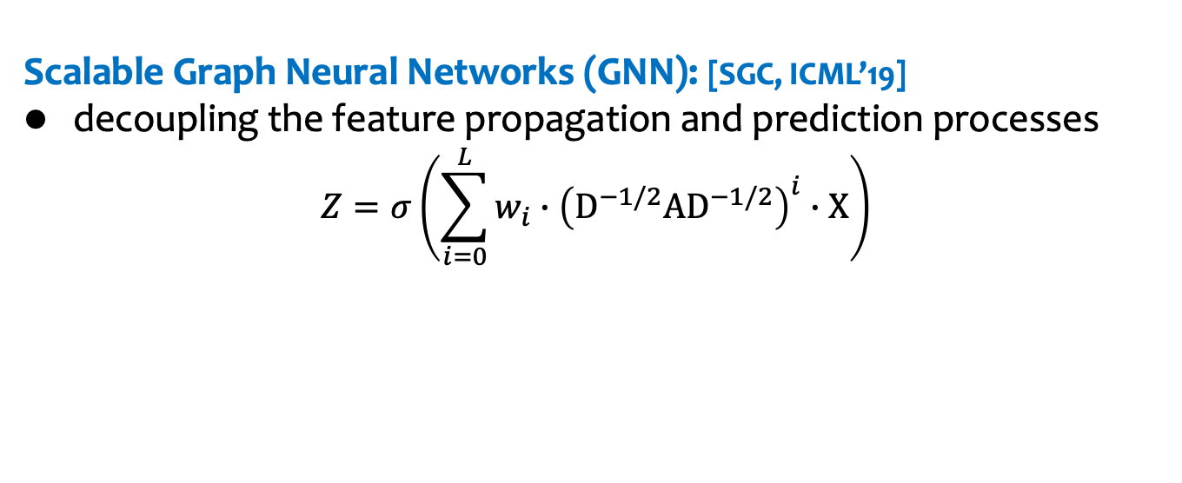
Graph Propagation in GNN
Scalable Graph Neural Networks (GNN): [SGC, ICML’19]
decoupling the feature propagation and prediction processes
$$Z=σ\left(\sum_{i=0}^{L}{w_{i}∙{\left({D^{−1/2}AD}^{−1/2}\right)}^{i}∙X}\right)$$
one column of the
feature matrix
10
feature propagation
9
0.03
0.1
0.03
0.3
0.2
0
0.1
0.01
0.08
0.03
0
0.12
12
2
1
8
3
11
4
6
5
7
Notes:
Moreover, the generalized graph propagation equation also covers the feature propagation process in Graph Neural Networks. In the work SGC, it proposes that we can decouple the feature propagation process and the prediction process for high scalability. That is, [Click!]given the feature matrix X, [Click!] we can first assign these features to corresponding nodes on the graph,and [Click!]propagate these features following the graph structures.

Slide 15

Graph Propagation in GNN
Scalable Graph Neural Networks (GNN): [SGC, ICML’19]
decoupling the prediction and feature propagation processes
$$Z=σ\left(\sum_{i=0}^{L}{w_{i}∙{\left({D^{−1/2}AD}^{−1/2}\right)}^{i}∙X}\right)$$
one column of the
feature matrix
10
feature propagation
9
0.03
0.1
0.03
0.3
0.2
0
0.1
0.01
0.08
0.03
0
0.12
12
2
1
8
3
11
4
6
5
7
Notes:
(Click!)(Click!)

Slide 16

Graph Propagation in GNN
Scalable Graph Neural Networks (GNN): [SGC, ICML’19]
decoupling the prediction and feature propagation processes
$$Z=σ\left(\sum_{i=0}^{L}{w_{i}∙{\left({D^{−1/2}AD}^{−1/2}\right)}^{i}∙X}\right)$$
prediction
structure
one column of the
propagation matrix
one column of the
feature matrix
10
feature propagation
9
0.23
0.01
0.1
0.1
0.2
0.01
0.1
0.18
0
0.03
0.1
0.02
0.03
0.1
0.03
0.3
0.2
0
0.1
0.01
0.08
0.03
0
0.12
12
2
1
8
3
11
$$σ$$
4
activation
6
5
7
Notes:
[Click!] Then we feed the final propagation matrix [Click!]to the prediction structures for downstream tasks.

Slide 17
Generalized Graph Propagation
Scalable Graph Neural Networks (GNN): [SGC, ICML’19]
decoupling the prediction and feature propagation processes
$$Z=σ\left(\sum_{i=0}^{L}{w_{i}∙{\left({D^{−1/2}AD}^{−1/2}\right)}^{i}∙X}\right)$$
transition probability
PPR
HKPR
propagation
structure
SGC [ICML’ 19]
APPNP [ICLP’ 19]
GDC [NeurIPS’ 19]
Notes:
Multiple GNN models follow this decoupled structure. For instance, in SGC, it uses the L-hop transition probability to propagate features. We can also use other node proximity models for feature propagation, such as PPR used in APPNP, or HKPR used in GDC. Note that in the original paper of APPNP and GDC, they also apply other complicated structures. Here, we only borrow the ideas to use PPR and HKPR for feature propagation and denote corresponding methods as APPNP and GDC.

Slide 18

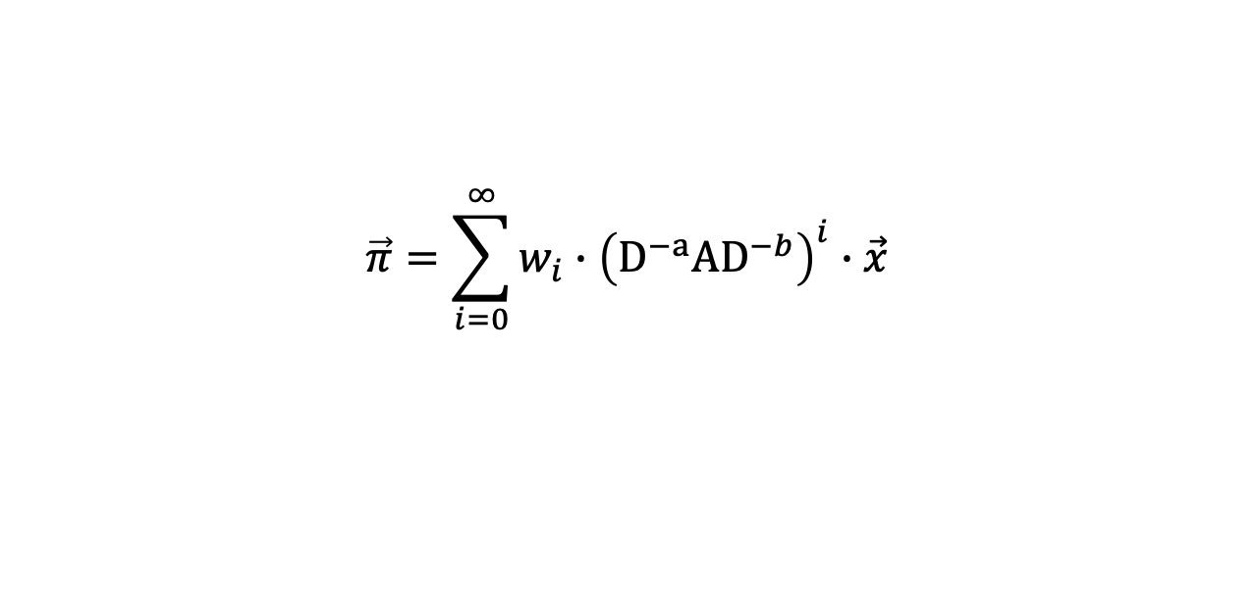
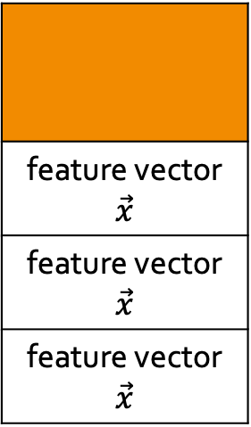
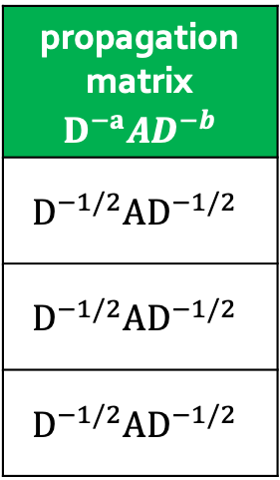
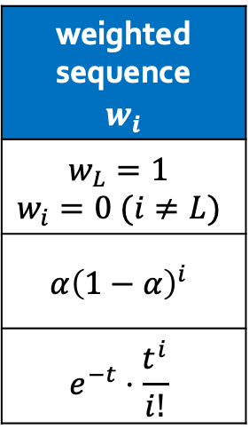
Generalized Graph Propagation
Scalable Graph Neural Networks (GNN): [SGC, ICML’19]
decoupling the prediction and feature propagation processes
$$Z=σ\left(\sum_{i=0}^{L}{w_{i}∙{\left({D^{−1/2}AD}^{−1/2}\right)}^{i}∙X}\right)$$
Generalized Graph Propagation Equation
$$\vec{π}=\sum_{i=0}^{∞}{w_{i}∙{\left({D^{−a}AD}^{−b}\right)}^{i}∙\vec{x}}$$
transition probability
PPR
HKPR
weighted sequence $$w_{i}$$
$$w_{L}=1$$ $$w_{i}=0 (i≠L)$$
$$α{\left(1−α\right)}^{i}$$
$$e^{−t}⋅\frac{t^{i}}{i!}$$
propagation matrix $${D^{−a}AD}^{−b}$$
$${D^{−1/2}AD}^{−1/2}$$
$${D^{−1/2}AD}^{−1/2}$$
$${D^{−1/2}AD}^{−1/2}$$
feature vector $$\vec{x}$$
feature vector $$\vec{x}$$
feature vector $$\vec{x}$$
propagation
structure
graph signal
$$\vec{x}$$
SGC [ICML’ 19]
APPNP [ICLP’ 19]
GDC [NeurIPS’ 19]
Notes:
Since these GNN models apply the node proximity metrics to propagate features. [Click!]We can summarize these GNN models into the generalized graph propagation equation,[Click!] with the paramters wi, a, b, and vector x. Note that in GNN’s feature propagation, the vector x denotes the columns of the given feature matrix.

Slide 19
Is there a unified algorithm to compute the generalized graph propagation equation?
Notes:
So here comes an interesting question: since we can generalize various node proximity metrics and GNN models into a graph propagation equation. Is there a unified algorithm to compute the generalized propagation equation?

Slide 20
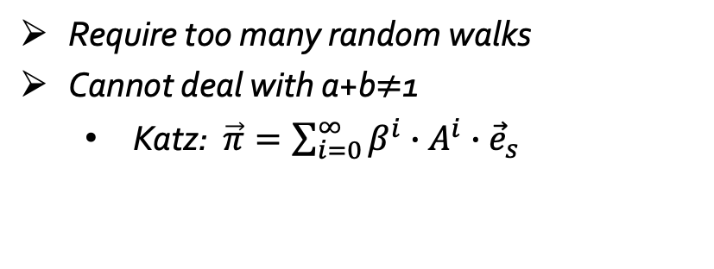
Monte-Carlo Methods
10
9
12
2
1
8
3
11
4
Require too many random walks
Cannot deal with a+b$≠$1
  Katz: $\vec{π}=\sum_{i=0}^{∞}{β^{i}∙A^{i}∙{\vec{e}}_{s}}$
6
5
7
Notes:
To compute the generalized graph propagation equation, a simple algorithm is the Monte-Carlo methods. （Click!）That we can generate multiply random walks to approximate the final probability distribution. While there are two main drawbacks of random walks. The first one is the Monte-Carlo method often needs to generate too many walks and cost lots of time. The second one is the Monte-Carlo method can not deal with the situation that a plus b doesn’t equal 1, such as in the Katz model.

Slide 21


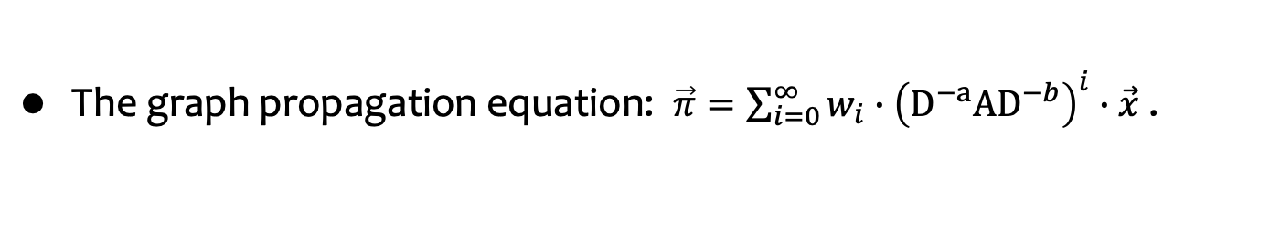




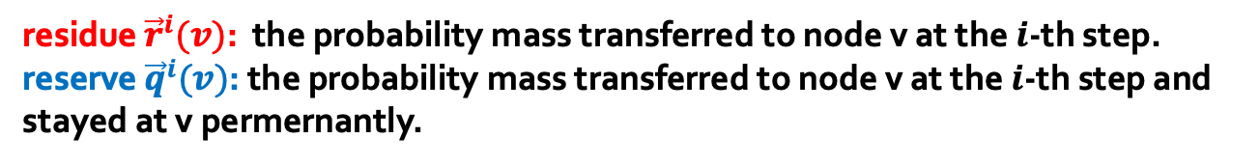



Deterministic Propagation [FOCS’06, NeurIPS’ 15]
The graph propagation equation: $\vec{π}=\sum_{i=0}^{∞}{w_{i}∙{\left({D^{−a}AD}^{−b}\right)}^{i}∙\vec{x}}$ .
residue ${\vec{r}}^{i}(v)$: the probability mass transferred to node v at the $i$-th step.
reserve ${\vec{q}}^{i}(v)$: the probability mass transferred to node v at the $i$-th step and stayed at v permernantly.
propagation vector $\vec{π}$
10
$$\vec{x}$$
9
0.23
0.01
0.1
0.1
0.2
0.01
0.1
0.18
0
0.03
0.1
0.02
0
0
0
1
0
0
0
0
0
0
0
0
${\vec{r}}^{1}\left(1\right)+\frac{Y_{1}}{Y_{0}}⋅\frac{{\vec{r}}^{0}\left(4\right)}{{d_{1}^{a}⋅d}_{4}^{b}}$
12
2
1
8
3
11
${\vec{r}}^{1}\left(3\right)+\frac{Y_{1}}{Y_{0}}⋅\frac{{\vec{r}}^{0}\left(4\right)}{{d_{3}^{a}⋅d}_{4}^{b}}$
4
${\vec{r}}^{0}\left(4\right)=0$
${\vec{r}}^{0}\left(4\right)=1$
${\vec{q}}^{0}\left(4\right)=\frac{w_{0}}{Y_{0}}⋅{\vec{r}}^{0}\left(4\right)$
6
5
repeat
${\vec{r}}^{1}\left(5\right)+\frac{Y_{1}}{Y_{0}}⋅\frac{{\vec{r}}^{0}\left(4\right)}{{d_{5}^{a}⋅d}_{4}^{b}}$
7
$Y_{i}=w_{i}+w_{i+1}+…$
Notes:
On the other hand, how about applying a deterministic propagation to compute the generalized propagation equation? In detail, we can view the vector x as the initial probability distribution and tries to propagate the probability mass step by step. [Click!]In the propagation process, we maintain two values for each node at each propagation level: residue and reserve. Specifcally, the residue records the probability mass transferred to the node at each step. And the reserve records the probability mass transferred to the node and permernantly stayed at the node. For example, in the given graph, [Click!] we suppose the initial probability distribution is an one-hot vector, that the source node 4 has all probability mass. [Click!]In the first propagation step, node 4 leaves some probability mass to its reserve, and transfers the other probability mass to its neighbors. Repeat this process until the increment of probability mass is below the error threshold. Then we can derive the final propagation vector \pi.

Slide 22





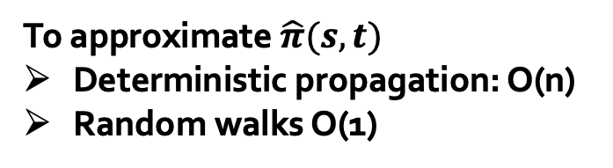
Deterministic Propagation
The graph propagation equation: $\vec{π}=\sum_{i=0}^{∞}{w_{i}∙{\left({D^{−a}AD}^{−b}\right)}^{i}∙\vec{x}}$ .
$$v_{1}$$
To approximate $\hat{π}(s,t)$
Deterministic propagation: O(n)
Random walks O(1)
$$v_{2}$$
$$v_{3}$$
s
t
…
$$v_{n−1}$$
$$v_{n}$$
Notes:
However, the deterministic propagation method may suffer from unnecessary cost. For example in the given graph, if we want to approximate the propagation results of pi(s,t). The deterministic propagation method has to propagate from s to each of v, then to t. While we find that, in this graph, the optimal solution is to generate only one random walks(Click!), which can definitely walks from s to t and only cost consant time.

Slide 23
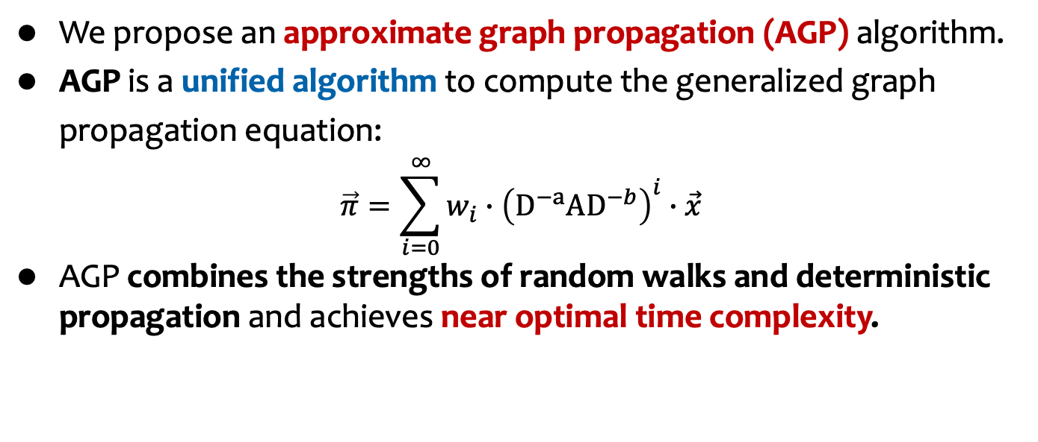
AGP: Approximate Graph Propagation
We propose an approximate graph propagation (AGP) algorithm.
AGP is a unified algorithm to compute the generalized graph propagation equation:
$$\vec{π}=\sum_{i=0}^{∞}{w_{i}∙{\left({D^{−a}AD}^{−b}\right)}^{i}∙\vec{x}}$$
AGP combines the strengths of random walks and deterministic propagation and achieves near optimal time complexity.
Various proximity metrics and GNN models
One unified graph propagation algorithm
transition probability | SGC
PPR | APPNP
HKPR | GDC
Katz | …
AGP
near optimal time complexity
Notes:
Hence, We propose an approximate graph propagtion algorithm AGP. In AGP, we combines the strengths of Monte-Carlo methods and the deterministic propagation methods. As a unifed approximate graph propagation algorithm, AGP achieves near optimal tim complexity. [Click!] Compared to prior studies, AGP gets rid of the case-by-case algorithm structure and uses a unfied algorithm to cover various proximity metrics and GNN models in near optimal time complexity. Now we show how AGP works.

Slide 24

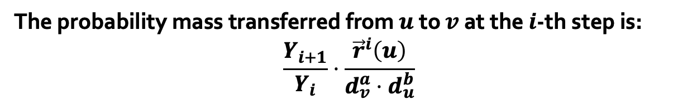
AGP: Approximate Graph Propagation
The graph propagation equation: $\vec{π}=\sum_{i=0}^{∞}{w_{i}∙{\left({D^{−a}AD}^{−b}\right)}^{i}∙\vec{x}}$ .
The probability mass transferred from $u$ to $v$ at the $i$-th step is:
$$\frac{Y_{i+1}}{Y_{i}}⋅\frac{{\vec{r}}^{i}\left(u\right)}{{d_{v}^{a}⋅d}_{u}^{b}}$$
larger degrees,
smaller increment
$${d_{v}^{a}⋅d}_{u}^{b}$$
10
9
${\vec{r}}^{1}\left(1\right)+\frac{Y_{1}}{Y_{0}}⋅\frac{{\vec{r}}^{0}\left(4\right)}{{d_{1}^{a}⋅d}_{4}^{b}}$
12
2
1
8
3
11
${\vec{r}}^{1}\left(3\right)+\frac{Y_{1}}{Y_{0}}⋅\frac{{\vec{r}}^{0}\left(4\right)}{{d_{3}^{a}⋅d}_{4}^{b}}$
4
6
5
${\vec{r}}^{1}\left(5\right)+\frac{Y_{1}}{Y_{0}}⋅\frac{{\vec{r}}^{0}\left(4\right)}{{d_{5}^{a}⋅d}_{4}^{b}}$
7
Notes:
(Click!) we notice that the transferred probability mass is in inverse proportion to the node degrees. That is, (Click!)the larger the node degrees are, the smaller the probability mass we transferred. A common sense is we can ignore those propagation with small transferred probability mass to save time.

Slide 25


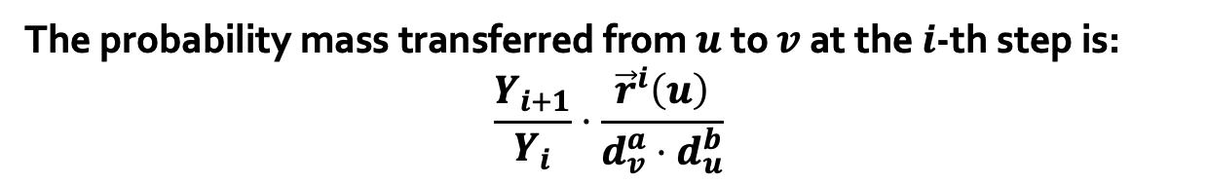





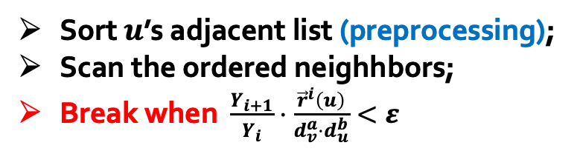




AGP: Approximate Graph Propagation
The probability mass transferred from $u$ to $v$ at the $i$-th step is:
$$\frac{Y_{i+1}}{Y_{i}}⋅\frac{{\vec{r}}^{i}\left(u\right)}{{d_{v}^{a}⋅d}_{u}^{b}}$$
larger degrees,
smaller increment
Sort $u$’s adjacent list (preprocessing);
Scan the ordered neighhbors;
Break when $\frac{Y_{i+1}}{Y_{i}}⋅\frac{{\vec{r}}^{i}\left(u\right)}{{d_{v}^{a}⋅d}_{u}^{b}}<ε$
$+\frac{Y_{i+1}}{Y_{i}}⋅\frac{{\vec{r}}^{i}\left(u\right)}{2^{a}⋅5^{b}}$
$$v_{1}$$
$+\frac{Y_{i+1}}{Y_{i}}⋅\frac{{\vec{r}}^{i}\left(u\right)}{3^{a}⋅5^{b}}$
$$v_{2}$$
$$u$$
$$v_{3}$$
$+\frac{Y_{i+1}}{Y_{i}}⋅\frac{{\vec{r}}^{i}\left(u\right)}{4^{a}⋅5^{b}}$
Can we ignore all the small probability mass?
$$v_{4}$$
$+\frac{Y_{i+1}}{Y_{i}}⋅\frac{{\vec{r}}^{i}\left(u\right)}{5^{a}⋅5^{b}}$
$$v_{5}$$
$+\frac{Y_{i+1}}{Y_{i}}⋅\frac{{\vec{r}}^{i}\left(u\right)}{6^{a}⋅5^{b}}$
Notes:
Hence, based on this intuition, (Click!) we can sort each node’s adjacent list in the ascending order of the neighbor nodes’ degrees. This sorting process can be finished when reading the graph. In the query phase, (Click!)we can scan the ordered adjacent list. (Click!)Once we find a probability mass to be transferred is below the error threshold. Then we straightly break the propagation from node u to save time. (Click!) However, this simple idea may confront with some bad cases and suffers from large approximation error.

Slide 26




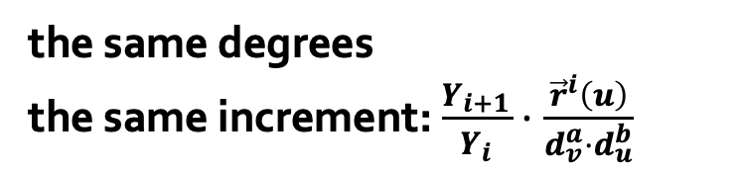




AGP: Approximate Graph Propagation
Sort $u$’s adjacent list (preprocessing);
Scan the ordered neighhbors;
Break when $\frac{Y_{i+1}}{Y_{i}}⋅\frac{{\vec{r}}^{i}\left(u\right)}{{d_{v}^{a}⋅d}_{u}^{b}}<ε$
$$v_{1}$$
$$v_{2}$$
$$u$$
$$v_{3}$$
$$q$$
…
$$v_{n−1}$$
the same degrees
the same increment: $\frac{Y_{i+1}}{Y_{i}}⋅\frac{{\vec{r}}^{i}\left(u\right)}{{d_{v}^{a}⋅d}_{u}^{b}}$
$$v_{n}$$
Notes:
As shown in the given example where node v1 to vn has the same degrees, when we propagate probability mass from node u to any node v, the proability mass to be transferred from u to v is also the same. Note that u’s degree is n and is large. Hence, the probability mass transferred to node v is small.

Slide 27








AGP: Approximate Graph Propagation
Sort $u$’s adjacent list (preprocessing);
Scan the ordered neighhbors;
Break when $\frac{Y_{i+1}}{Y_{i}}⋅\frac{{\vec{r}}^{i}\left(u\right)}{{d_{v}^{a}⋅d}_{u}^{b}}<ε$
1. Ignore all edges:
$$v_{1}$$
wrong approximation
$$\hat{π}\left(q\right)=0$$
$$v_{2}$$
$$u$$
$$v_{3}$$
$$q$$
…
$$v_{n−1}$$
$$v_{n}$$
Notes:
According to our previous idea, if the probability increment is smaller than the error threshold, we can ignore all the adjacent nodes with the same or the larger degrees. However, in this example, if we ignore all the adjacent nodes v, we will propagate nothing from u to v, then to q. (Click!) Hence, the approximation of pi(u,q) is zero. While, we find that even though the probability mass transferred to each v is small, but there are n edges to propagate mass, leading to an unavoidable value of pi(u,q).

Slide 28





AGP: Approximate Graph Propagation
Sort $u$’s adjacent list (preprocessing);
Scan the ordered neighhbors;
Break when $\frac{Y_{i+1}}{Y_{i}}⋅\frac{{\vec{r}}^{i}\left(u\right)}{{d_{v}^{a}⋅d}_{u}^{b}}<ε$
1. Ignore all edges:
$$v_{1}$$
wrong approximation
$$\hat{π}\left(q\right)=0$$
$$v_{2}$$
2. Push through each edges:
$$u$$
$$v_{3}$$
$$q$$
large cost O(n)
…
$$v_{n−1}$$
$$v_{n}$$
Notes:
So in order to return the qualified approximation results, we cannot ignore all these edges. (Click!) And this can lead to large time cost because we need to do the propagation from node u to each v.

Slide 29








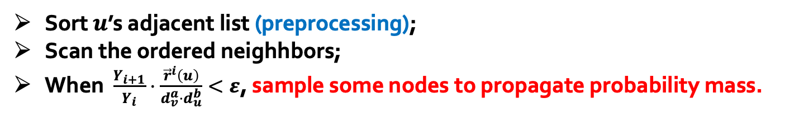
AGP: Approximate Graph Propagation
Sort $u$’s adjacent list (preprocessing);
Scan the ordered neighhbors;
When $\frac{Y_{i+1}}{Y_{i}}⋅\frac{{\vec{r}}^{i}\left(u\right)}{{d_{v}^{a}⋅d}_{u}^{b}}<ε$, sample some nodes to propagate probability mass.
$$v_{1}$$
sample $v_{k}$ with probability $\frac{1}{ε}⋅\frac{Y_{i+1}}{Y_{i}}⋅\frac{{\vec{r}}^{i}\left(u\right)}{{d_{v}^{a}⋅d}_{u}^{b}}$ .
transfer $ε$ to the selected $v_{k}$for unbiasedness
$$v_{2}$$
$$u$$
$$v_{3}$$
$$q$$
…
$$v_{n−1}$$
How can we sample neighbors without checking each neighbor one by one?
$$v_{n}$$
Notes:
In order to figure out this problems, in AGP,(Click!) we propses to sample some nodes to propagate probability mass. By this means, we will not cost much time, and (Click!) we can modify the sampling probability to guarantee unbiasedness of the approximation. However, (Click!) there comes another difficiulty: how can we sample the neighbors without checking each of them one by one.

Slide 30


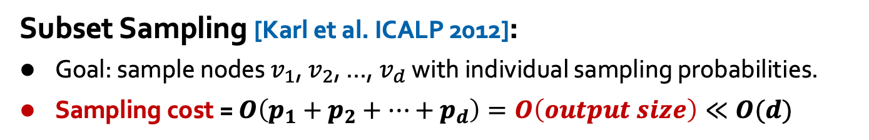












AGP: Approximate Graph Propagation
Subset Sampling [Karl et al. ICALP 2012]:
Goal: sample nodes $v_{1}$, $v_{2}$, …, $v_{d}$ with individual sampling probabilities.
Sampling cost = $O\left(p_{1}+p_{2}+…+p_{d}\right)=O\left(output size\right)≪O(d)$
sampling results
$$v_{2}$$
$$v_{4}$$
…
$$v_{1}$$
$$v_{2}$$
$$v_{3}$$
$$v_{4}$$
$$v_{d−1}$$
$$v_{d}$$
Sampling probability
$$p_{1}$$
$$p_{2}$$
$$p_{3}$$
$$p_{4}$$
$$p_{d−1}$$
$$p_{d}$$
Notes:
Here we use a sampling technique called subset sampling to guarantee we can sample the nodes with individual sampling probabilities, and the cost of sampling is linear with the output size, rather than the number of sampling nodes.

Slide 31


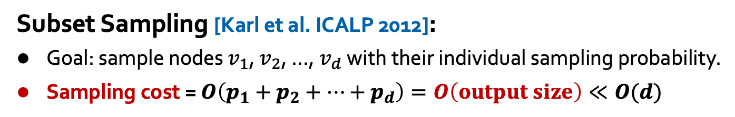








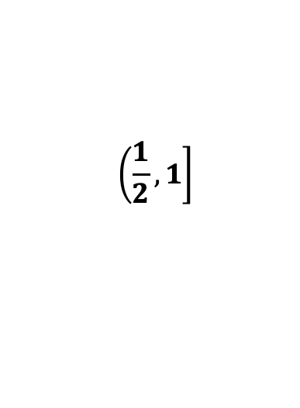

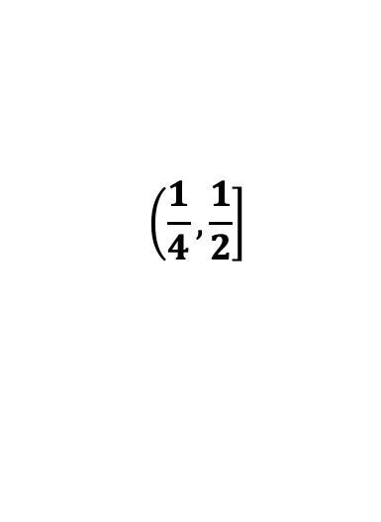





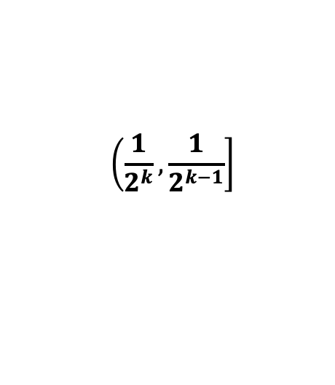

AGP: Approximate Graph Propagation
Subset Sampling [Karl et al. ICALP 2012]:
Goal: sample nodes $v_{1}$, $v_{2}$, …, $v_{d}$ with their individual sampling probability.
Sampling cost = $O\left(p_{1}+p_{2}+…+p_{d}\right)=O\left(output size\right)≪O(d)$
$$p∈$$
$$\left(\left.\frac{1}{2^{k}},\frac{1}{2^{k−1}}\right]\right.$$
$$\left(\left.\frac{1}{4},\frac{1}{2}\right]\right.$$
$$\left(\left.\frac{1}{2},1\right]\right.$$
$$…$$
$$v_{1}$$
$$v_{3}$$
$$v_{d}$$
$$…$$
$$v_{d−1}$$
$$v_{2}$$
$$v_{4}$$
$$p_{1}$$
$$p_{3}$$
$$p_{d}$$
$$p_{d−1}$$
$$p_{2}$$
$$p_{4}$$
$p_{k}=\frac{1}{2^{k−1}}$
$p_{2}=\frac{1}{2^{1}}$
$p_{1}=\frac{1}{2^{0}}$
…
$$v_{1}$$
$$v_{2}$$
$$v_{3}$$
$$v_{4}$$
$$v_{d−1}$$
$$v_{d}$$
Sampling probability
$$p_{1}$$
$$p_{2}$$
$$p_{3}$$
$$p_{4}$$
$$p_{d−1}$$
$$p_{d}$$
Notes:
More precisely, in subset sampling, (Click!)we partition the nodes into logn groups according to their sampling probabilities. The k-th group contains the nodes whose sampling probability is in 1 over the k power of 2. Note that the sampling probabilities of the nodes in a group differs by a factor smaller than 2. (Click!) Hence, we treat the nodes in a group with the same sampling probability and do the binomial smapling.

Slide 32
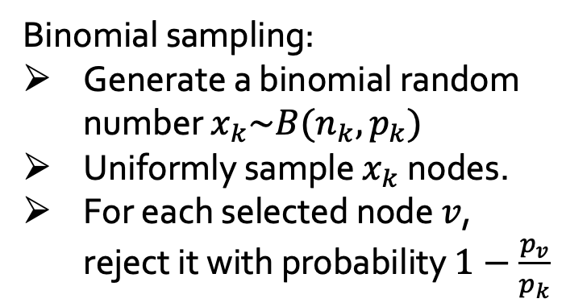

AGP: Approximate Graph Propagation
Subset Sampling [Karl et al. ICALP 2012]:
Goal: sample nodes $v_{1}$, $v_{2}$, …, $v_{d}$ with their individual sampling probability.
Sampling cost = $O\left(p_{1}+p_{2}+…+p_{d}\right)=O\left(output size\right)≪O(d)$
$$p∈$$
$$\left(\left.\frac{1}{2^{k}},\frac{1}{2^{k−1}}\right]\right.$$
Binomial sampling:
Generate a binomial random number $x_{k}\sim B(n_{k},p_{k})$
Uniformly sample $x_{k}$ nodes.
For each selected node $v$, reject it with probability $1−\frac{p_{v}}{p_{k}}$
$$v_{1}$$
$$v_{3}$$
$$v_{d}$$
$$p_{1}$$
$$p_{3}$$
$$p_{d}$$
$p_{k}=\frac{1}{2^{k−1}}$
the k-th group contains $n_{k}$ nodes
Cost$=O\left(n_{k}⋅p_{k}\right)=O\left(output size\right)≪O\left(n_{k}\right)$
Notes:
That is, (Click!)we first generate a binomial random number xk for the k-th group. (Click!)Then we uniformly and randomly sample xk nodes from this group. (Click!)Finally, we offer one more revised check to guarantee unbiasedness. (Click!)In this process, the time cost spent to smaple nodes in the k-th group is at the same level as the output size, which is far smaller than the total number of nodes in this groups.

Slide 33











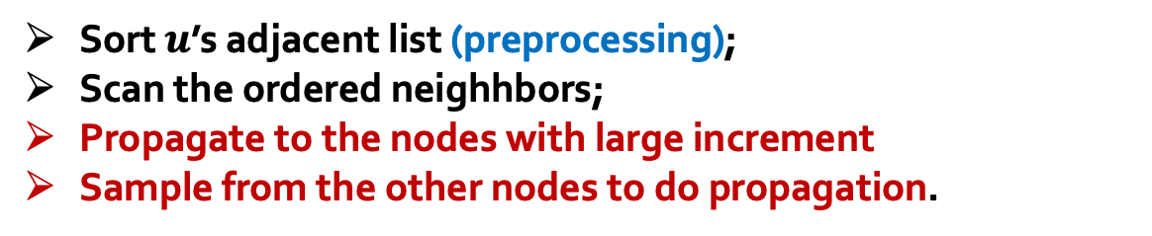
AGP: Approximate Graph Propagation
Sort $u$’s adjacent list (preprocessing);
Scan the ordered neighhbors;
Propagate to the nodes with large increment
Sample from the other nodes to do propagation.
$+\frac{Y_{i+1}}{Y_{i}}⋅\frac{{\vec{r}}^{i}\left(u\right)}{2^{a}⋅5^{b}}$
$$v_{1}$$
propagate deterministically
$+\frac{Y_{i+1}}{Y_{i}}⋅\frac{{\vec{r}}^{i}\left(u\right)}{3^{a}⋅5^{b}}$
$$v_{2}$$
$$u$$
$$v_{3}$$
$+\frac{Y_{i+1}}{Y_{i}}⋅\frac{{\vec{r}}^{i}\left(u\right)}{4^{a}⋅5^{b}}$
$$v_{4}$$
$+\frac{Y_{i+1}}{Y_{i}}⋅\frac{{\vec{r}}^{i}\left(u\right)}{5^{a}⋅5^{b}}$
Sample nodes to do propagation
$$v_{5}$$
$+\frac{Y_{i+1}}{Y_{i}}⋅\frac{{\vec{r}}^{i}\left(u\right)}{6^{a}⋅5^{b}}$
Notes:
To summarize, (Click!)AGP only deterministically propagate the large probability mass. For other edges, (Click!)AGP applies the subset sampling technique to sample some nodes to propagate probability. In this way, AGP saves much time without obvious error increment.

Slide 34
Experiments
Local clustering with HKPR
Datasets:
Datasets | Type | # of nodes n | # of edges m
Youtube | undirected | 1,138,499 | 5,980,886
Orkut | undirected | 3,072,441 | 234,369,798
Twitter | directed | 41,652,230 | 1,468,364,884
Friendster | undirected | 68,349,466 | 3,623,698,684
Dataset source: http://snap.stanford.edu/data/index.html. http://law.di.unimi.it/datasets.php.
Notes:
In the experiment part, we conduct two kinds of experiments: local clustering with HKPR proximity metrics, and node classification with GNN models. In the local clustering experiments, we use four large datasets and choose maxError and conductance to evaluate the performace of AGP.

Slide 35
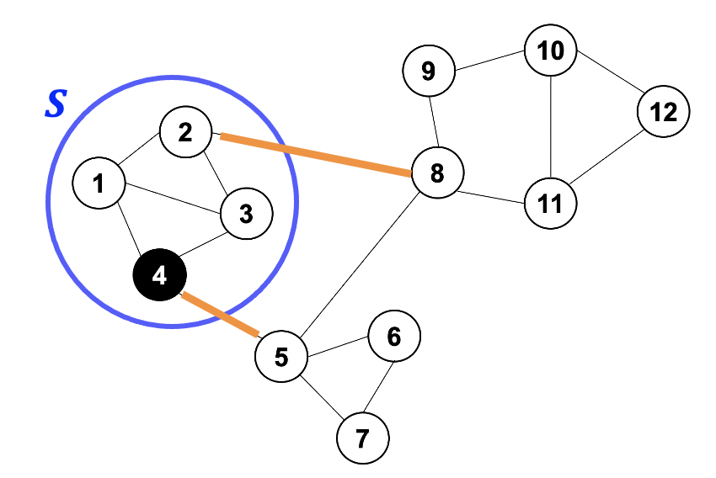


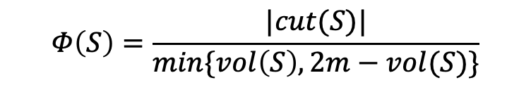
Experiments
Local clustering with HKPR
Metrics:
  MaxError $=\frac{1}{n}\max_{1≤i≤n}{|\tilde{π}\left(v_{i},t\right)−π(v_{i},t)|}$
  Conductance: to measure the quality of the cluster algorithms
    the smaller, the better.
conductance:
$$Φ\left(S\right)=\frac{|cut(S)|}{min\{vol\left(S\right),2m−vol(S)\}}$$
$\left|cut\left(S\right)\right|=2$
Notes:
The conducatnce is a popular mesurement to evalue the quality of the clustering algorithm. It is defined by the fraction of the number of cut edges and the set volume. Hence, the conductance is the smaller , the better

Slide 36
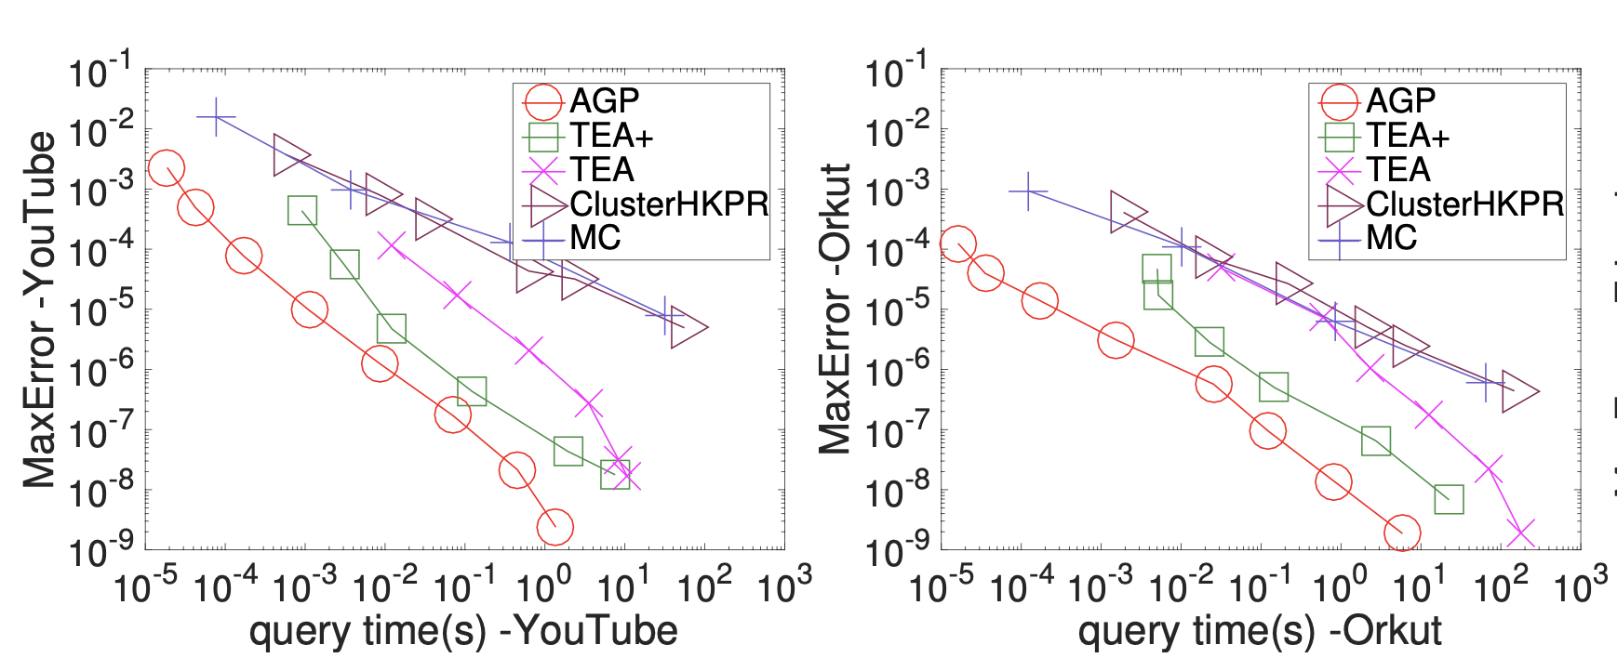
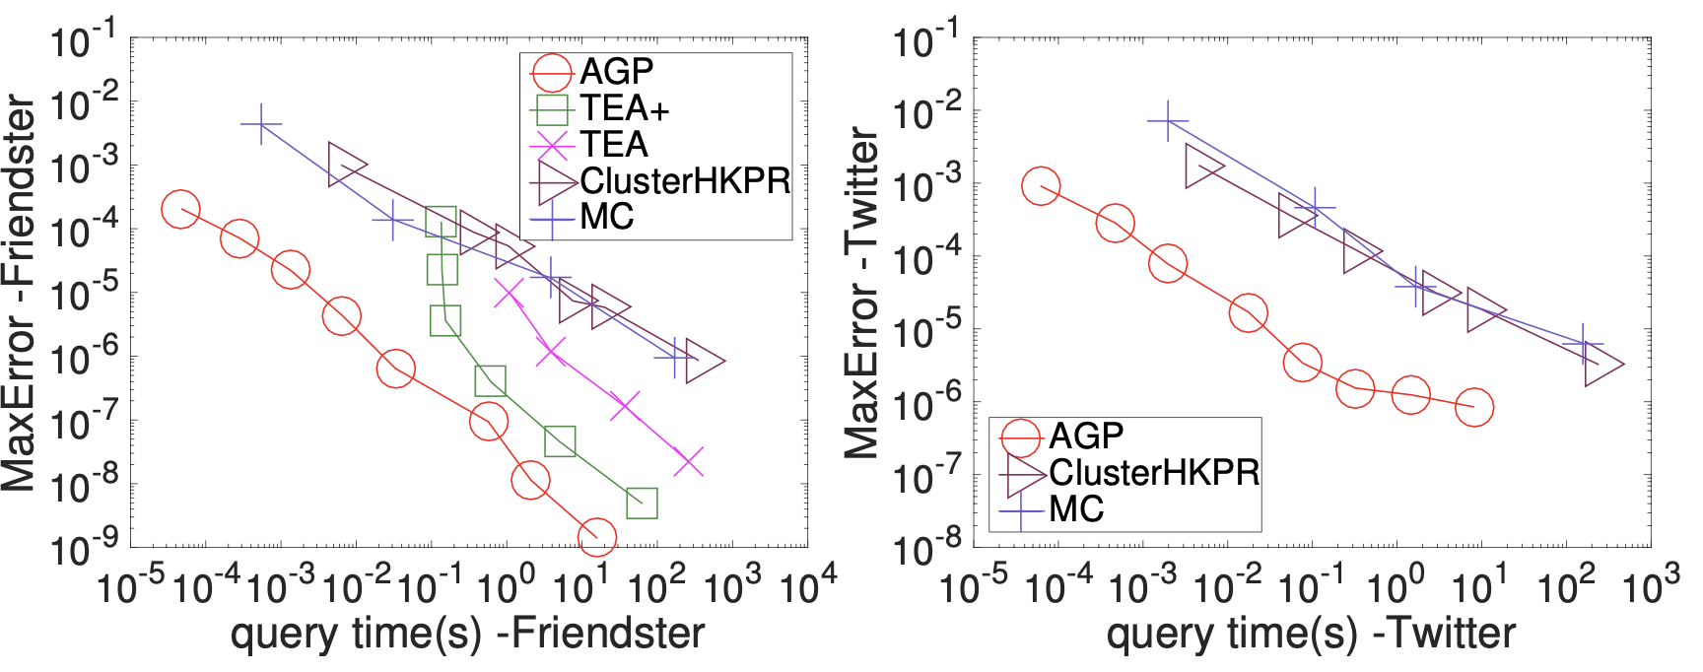
Experiments: Local clustering with HKPR
MaxError v.s. query time
Notes:
We first plot the trade-offs between maxError and query time. We use the red line with circle to denote the results of AGP. We compare AGP with four baseline methods. Among them, TEA+ is the state-of-the-art of local clustering as far as we know. We observe that AGP outperforms other competitors in terms of query efficiency.

Slide 37
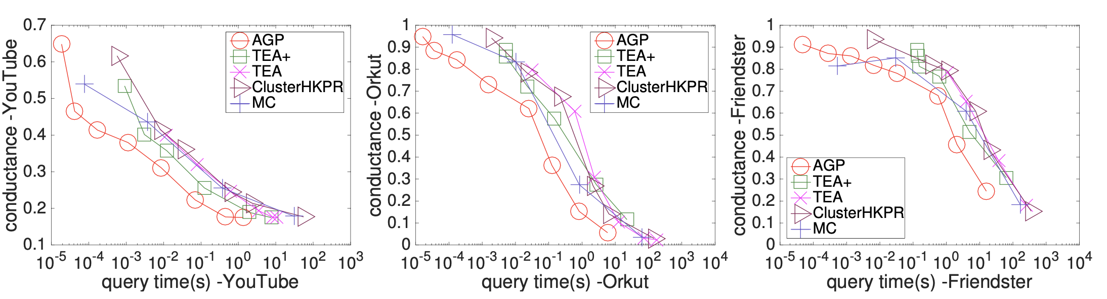
Experiments: Local clustering with HKPR
Conductance v.s. query time (the smaller, the better)
Notes:
Besides, we also compare the conductance of each clustering methods. Conductance is a metric to evaluet the clustering’ quality. The smaller conductance means the better performance. We note that AGP can always achieve the smallest conductance on all datasets.

Slide 38
Experiments
Node classification with GNN
Datasets:
Datasets | # of nodes n | # of edges m | Feature dimension | Classes | Label %
Reddit | 232,965 | 114,615,892 | 602 | 41 | 0.0035
Yelp | 716,847 | 6,977,410 | 300 | 100 | 0.7500
Amazon | 2,449,029 | 61,859,140 | 100 | 47 | 0.7000
Papers100M | 111,059,956 | 1,615,685,872 | 128 | 172 | 0.0109
the largest publicly available GNN dataset so far
Dataset source: http://snap.stanford.edu/data/index.html. http://law.di.unimi.it/datasets.php.
Notes:
In the experiments of node classification with GNN Models, we select four datasets. (Click!)Among them, papers100M is the largest available GNN dataset with 1 billion edges.

Slide 39
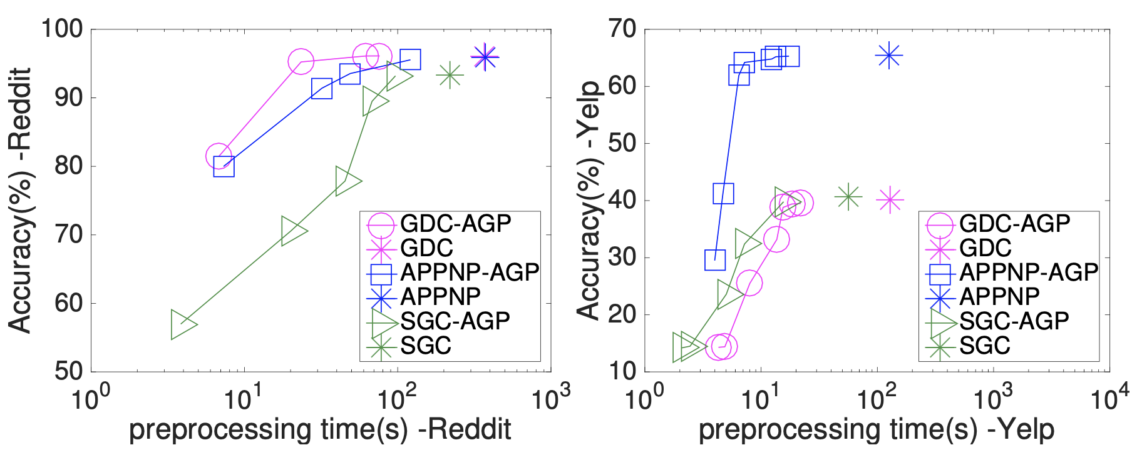
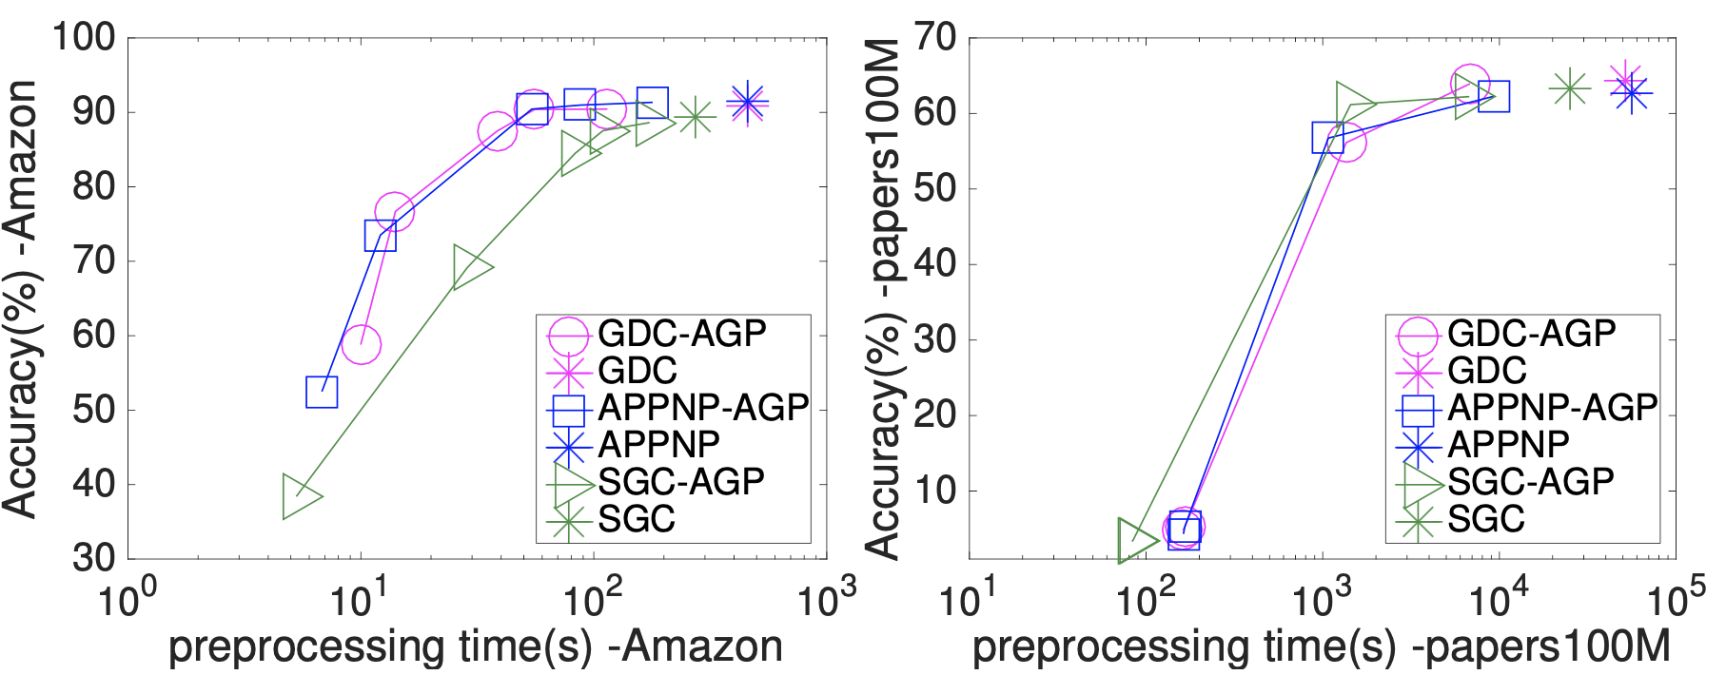
Experiments: Node classification with GNN
Accuracy (%) v.s. graph propagation time
The vanilla method
augment the original GNN models with AGP to propagate features.
Notes:
We consider three GNN models: SGC, APPNP and GDC. (Click!)We augment the three models with AGP to abtain three variants SGC-AGP, APPNP-AGP and GDC-AGP. (Click!) We observe that the AGP-variant models adhieve 10 times speedup in the propagation timw without sacrificing the classification accuracy.

Slide 40
Conclusion
AGP is a unified randomized algorithm which computes various proximity metrics and GNN models.
AGP combines the strengths of Monte-Carlo method and the deterministic propagation method, and achieves near optimal time complexity.
AGP extends existing GNN models to papers100M, the largest publicly available GNN dataset so far.
Notes:
In conclusion, AGP is a unified randomized algorithm which computes various proximity metrics and GNN feature propagation.
(Click!) AGP combines the strengths of Monte-Carlo methods and the deterministic propagation methods, and achieves near optimal time complexity.
(Click!) AGP extends existing GNN models to papers100M, the largest GNN dataset so far.

Slide 41
Thank you!
Approximate Graph Propagation
Notes:
That’s all of our presentation. Thank you.

